Slide 1
Predicting Customer Booking Behavior
Using Machine Learning for Customer Engagement

Slide 2
Background
• Customers have access to a wealth of information.
• Waiting for purchases at the airport is too late.
• Objective: Predict booking likelihood in advance to engage proactively.

Slide 3
Dataset Overview
• 10,001 Rows | 17 Columns
• Features: Booking Channel, Class, Departure/Arrival Region, Haul Type, Fare Amount
• Target: Booking Completed (Yes/No)

Slide 4
Approach and Methodology
• Data Cleaning and Encoding
• Feature Engineering (e.g., booking month)
• Algorithms Used:
- RandomForestClassifier (Primary)
- • Metrics: Accuracy, ROC-AUC, Cross-Validation

Slide 5
Results & Key Findings
• Best Model: Random Forest
• Accuracy: ~0.86 %
• ROC-AUC: ~0.77
Cross Validation Score (Mean): 0.49
Most Important Features:
- purchase_lead (0.19)
- route (0.15)
- flight_hour (0.14)
- length_of_stay (0.13)
- booking_origin (0.11)

Slide 6
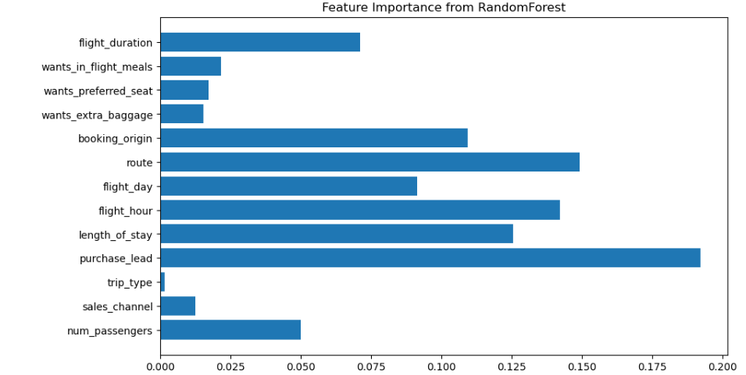
Feature Importance from RandomForest

Slide 7
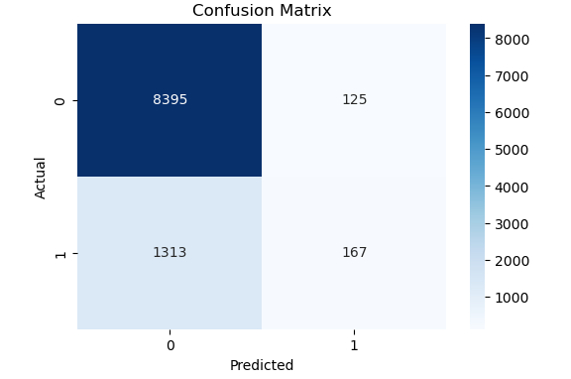
Confusion Matrix Actual vs Predicted

Slide 8
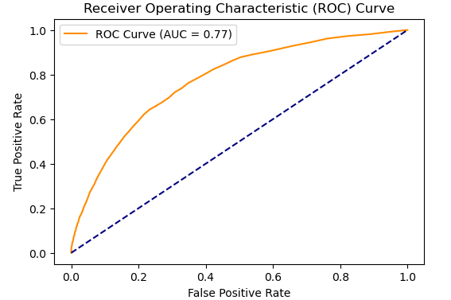
ROC Curve

Slide 9
Conclusion
✅ Model predicts booking likelihood effectively.
✅ Supports proactive customer engagement.
✅ Optimizes lounge usage, promotions, and resource planning.
✅ Next: Integration with business systems, model refinement.

